Slide 1
Stabilizing an Inverted Pendulum
Hiral Mistry and David Goniodsky
EE 547 PMP Project

Slide 2
Overview
Minseg Model
Stability, Controllabiltity, Observability
Design of Estimator
Design of Controller
Measuring Moment of Inertia
Measuring all states from Sensors
Gyroscope offset setting
Challenges to Set Gain
Demo

Slide 3
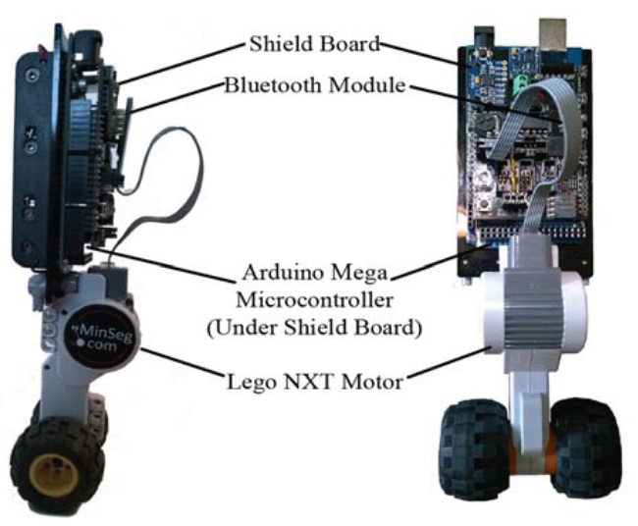
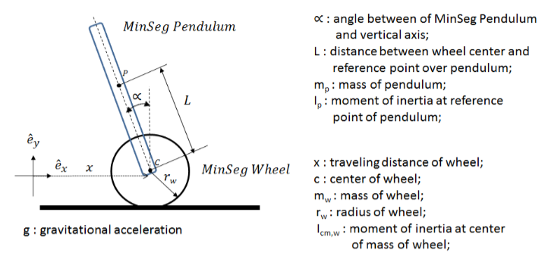
Minseg Model
Nonlinear System
Linearized around equilibrium point

Slide 4
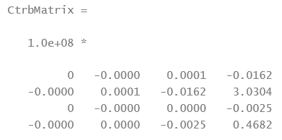
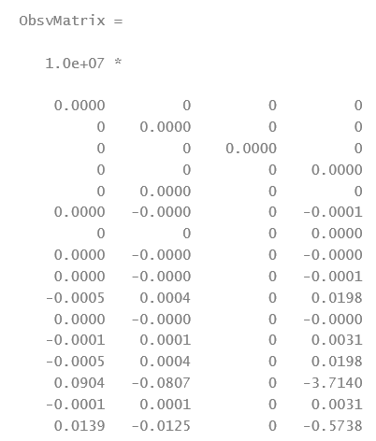
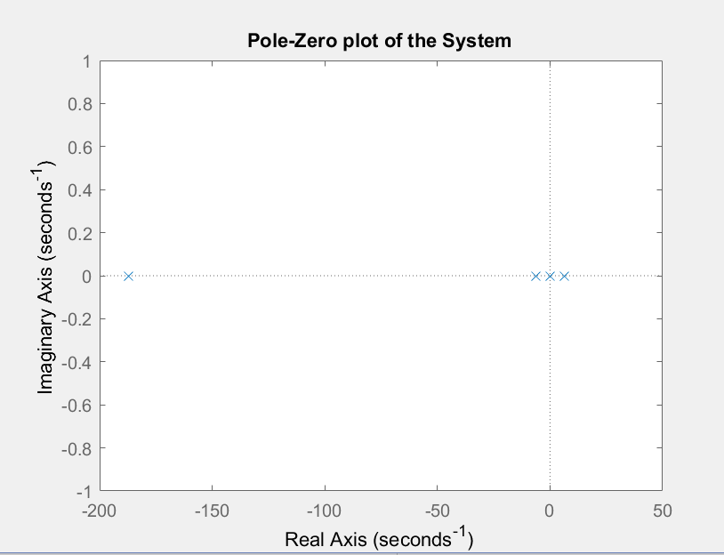
Stability, Controllability, Observability
Unstable
Controllable
Observable
Controllability Matrix Rank= 4
Observability Matrix Rank= 4

Slide 5
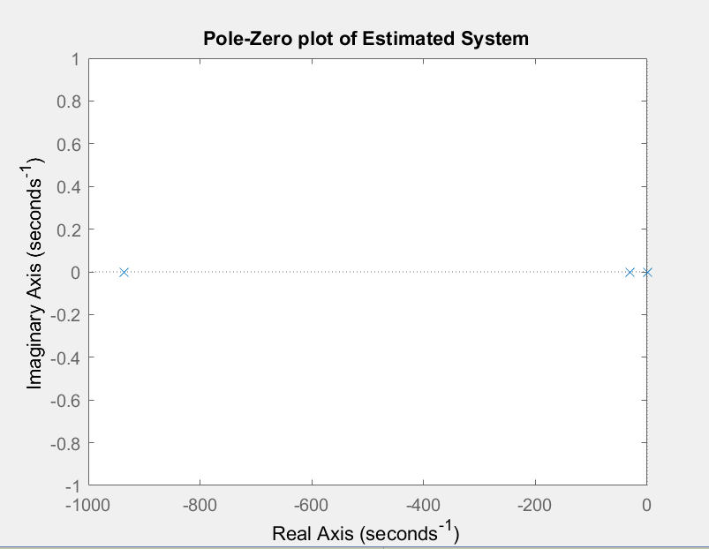
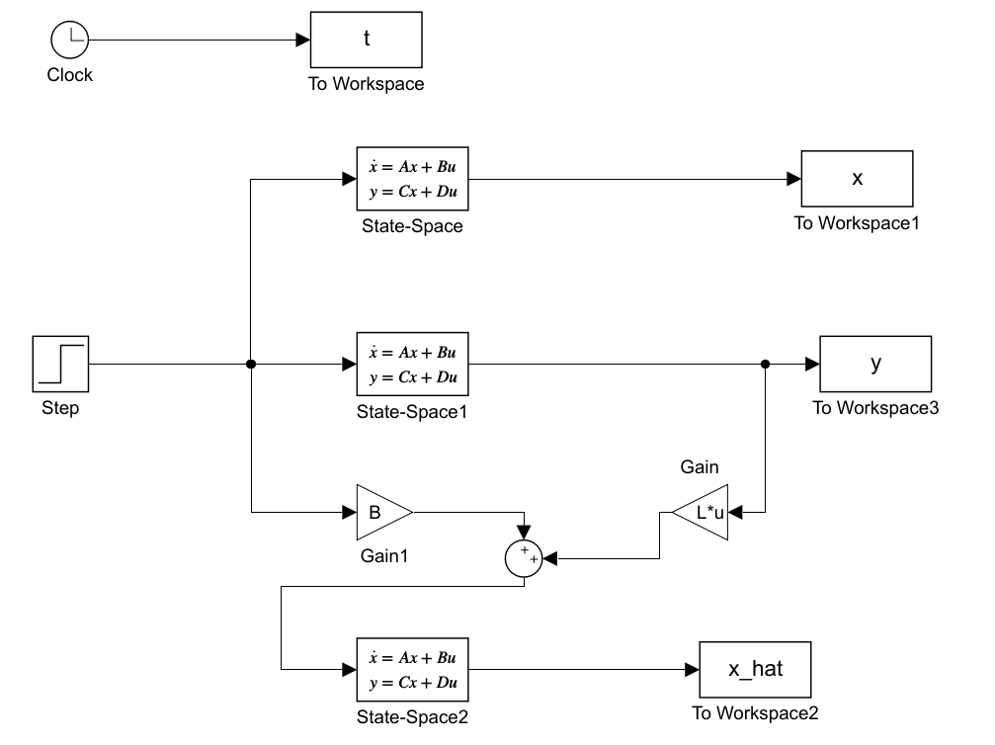
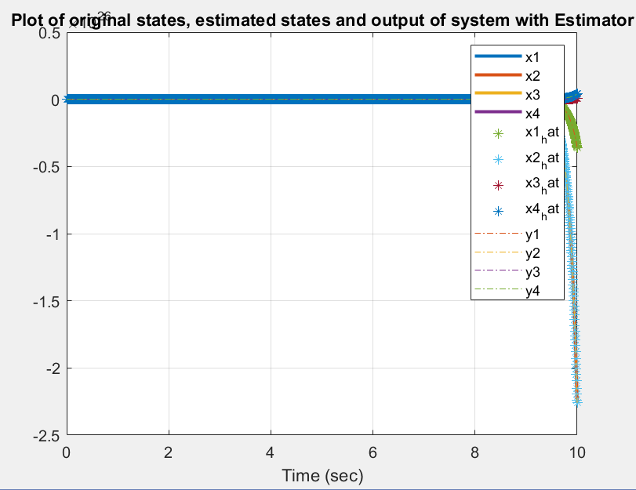
Design of Estimator
Poles= [0 -935.5185 -31.3975 -30.7085]
System unstable
System states are estimated
Xhat follows x.
Simulink model of system with Estimator

Slide 6
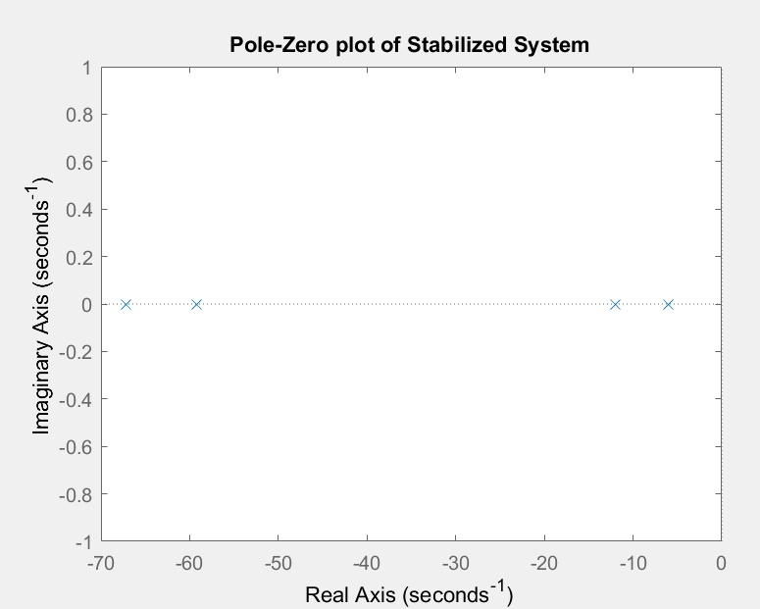
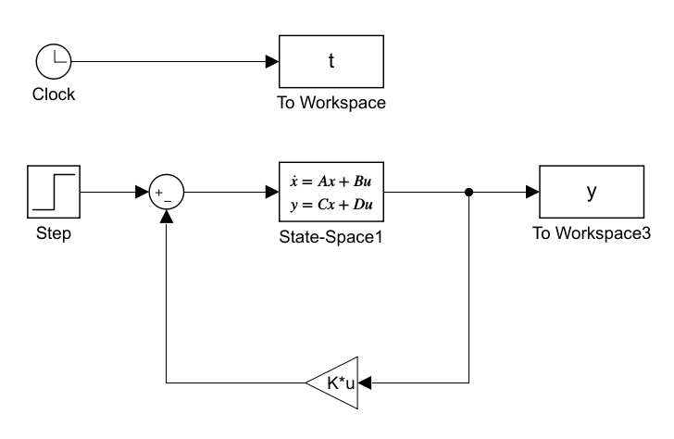
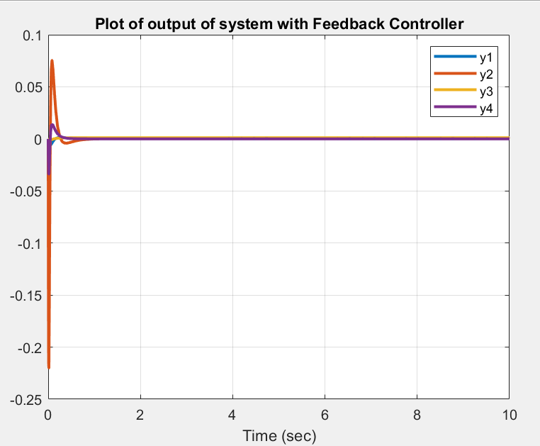
Design of Controller
Stable System
Output is bounded

Slide 7
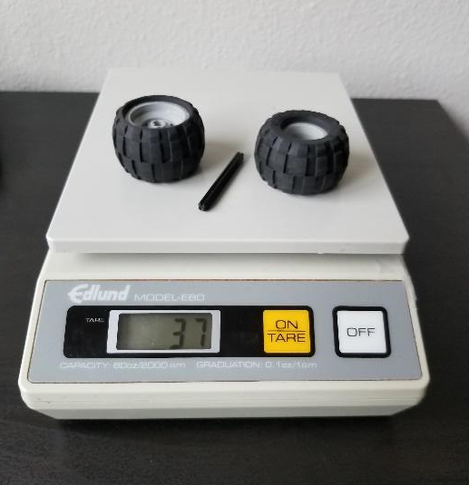

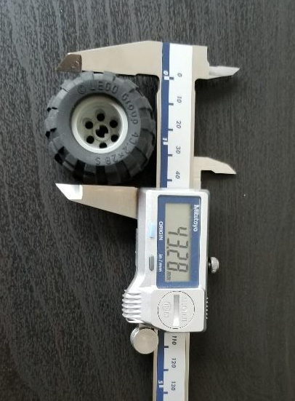
Measuring Moment of Inertia of Wheel (Icm,w)
Run | Distance Travelled (m) | Time consumed (sec)
1 | 0.281 | 0.74
2 | 0.281 | 0.8
3 | 0.281 | 0.79
4 | 0.281 | 0.66
5 | 0.281 | 0.59
6 | 0.281 | 0.66
7 | 0.281 | 0.86
8 | 0.281 | 0.73
9 | 0.281 | 0.67
10 | 0.281 | 0.66
Measured Average Velocity(v)= 0.3924 m/s
Measured Initial height of ramp (h)= 0.04255 m
g =9.80665 m/S2
Radius of wheel(r)=0.0216 m
Mass of both wheels(m)=0.037 kg
Calculated value of moment of Inertia (Icm,w)= 7.62997e-5 kg.m2
r
m
v
h
g

Slide 8
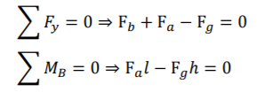
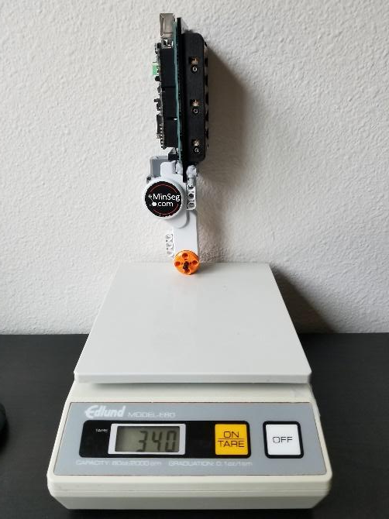
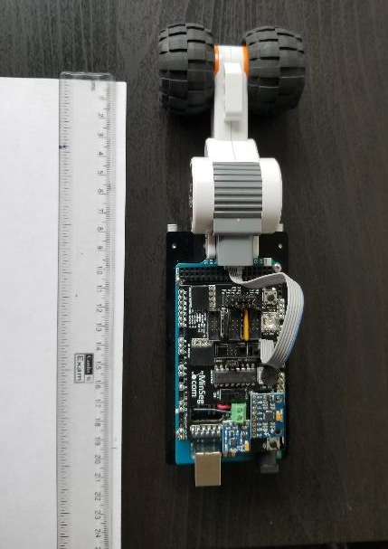
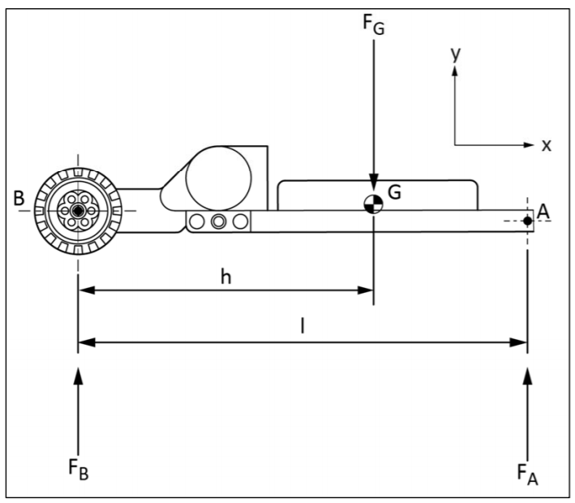

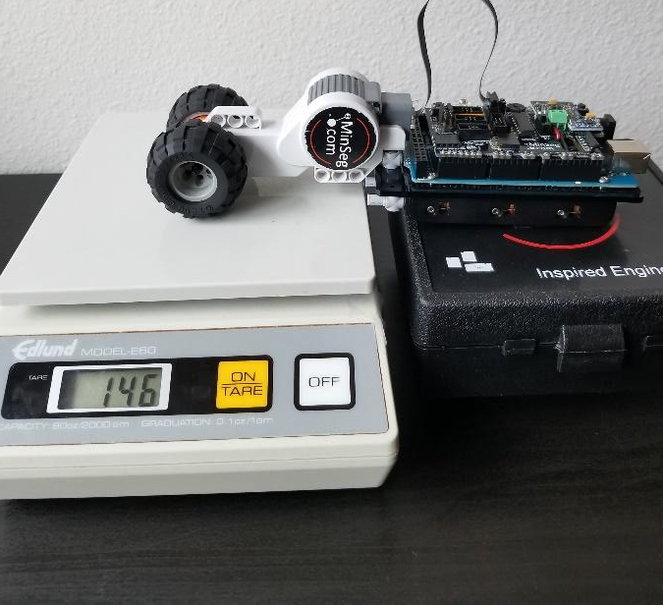
Measuring Moment of Inertia of Pendulum (Ip)
Measuring the distance between center of wheel and reference point on pendulum (h)
Equation of period of oscillation
Measured Fg=340+37+4=381 gm
Measured length of pendulum (l)= 19.5 cm
Calculated value of distance between center of wheel and reference point on pendulum (h) = 0.07472 m
Measured Fb=146 gm

Slide 9
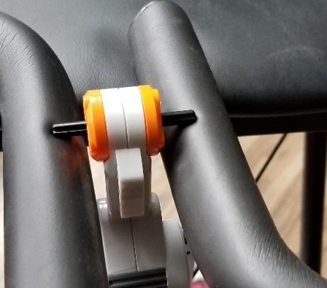
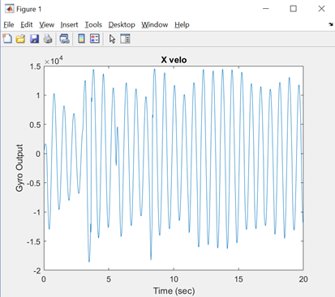
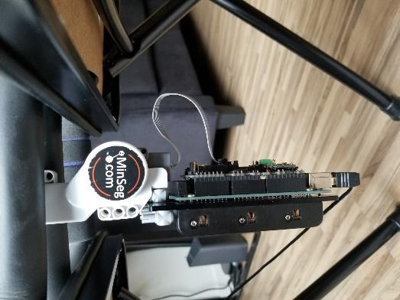

Measuring Moment of Inertia of Pendulum (Ip)
Measuring the time period of Oscillations and Calculating Moment of Inertia (Ip)
Measure time period of oscillation (T)= 0.714 sec
Mass of pendulum (m) = 0.381 kg
g = 9.80665 m/S2
h = 0.07472 m
Calculated value of moment of Inertia (Ip) =3.60511562e-3 kg.m2
Arrangement for suspending Minseg

Slide 10
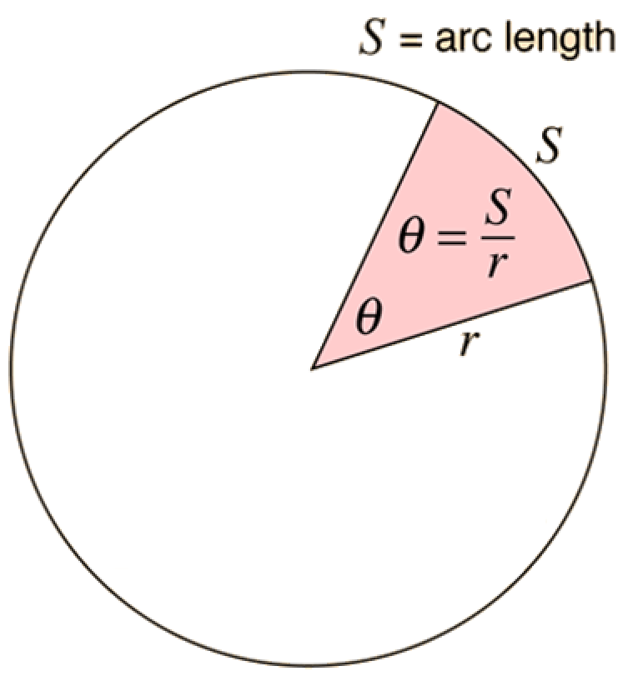
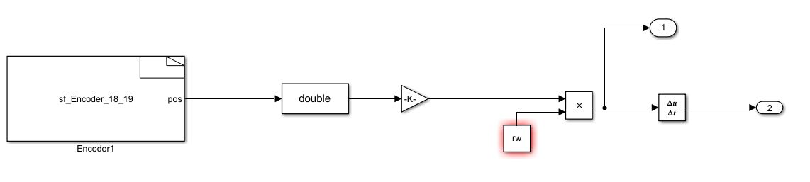
Measuring horizontal Position and Velocity

Slide 11
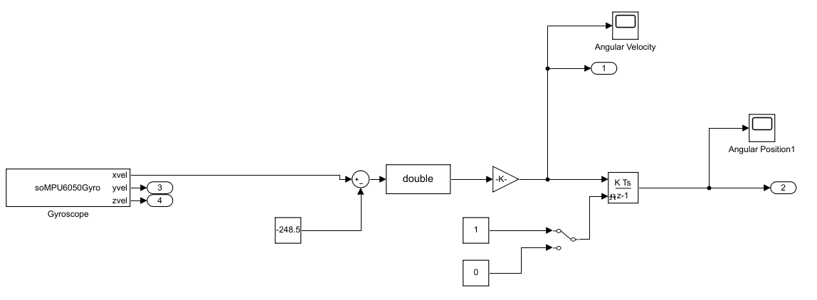
Gyroscope with simple offset correction
Significant offset error

Slide 12
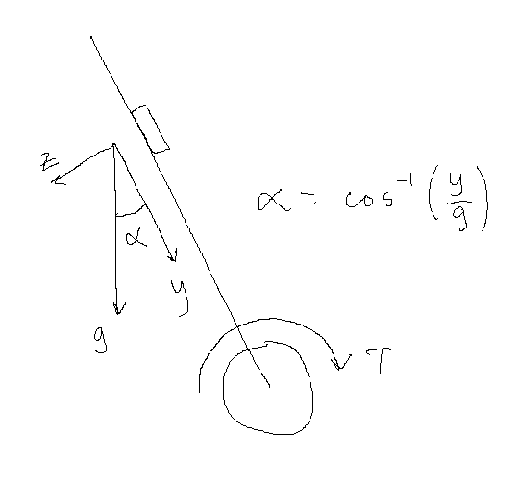
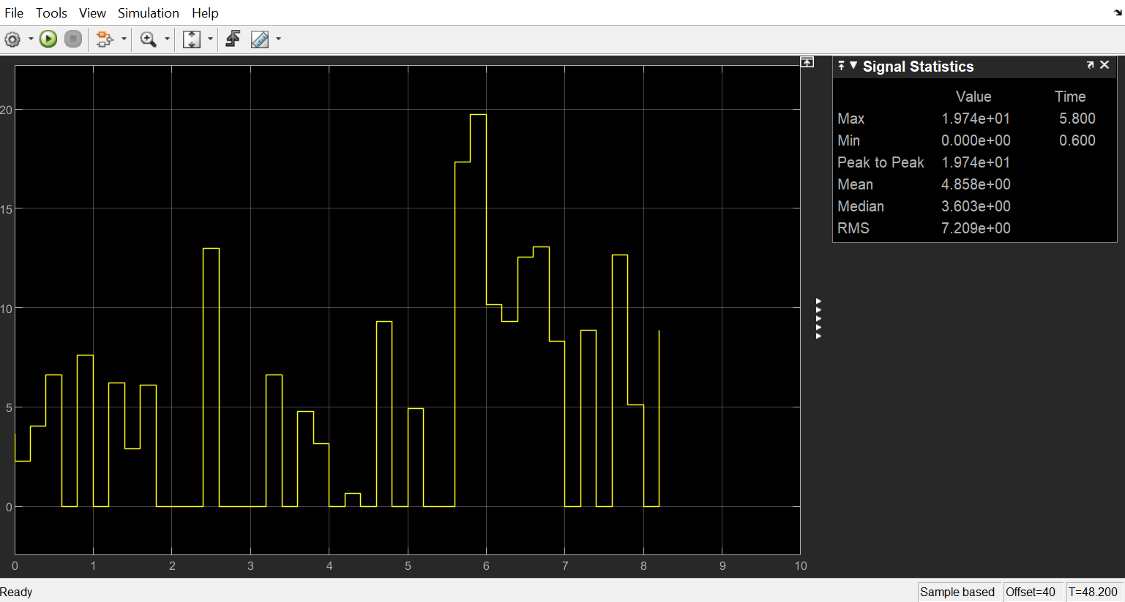
Measuring Angular Position with Accelerometer
Accelerometer y axis is always perpendicular to the torque from the motor.
No offset
Very slow
Still needs sign from gyroscope

Slide 13
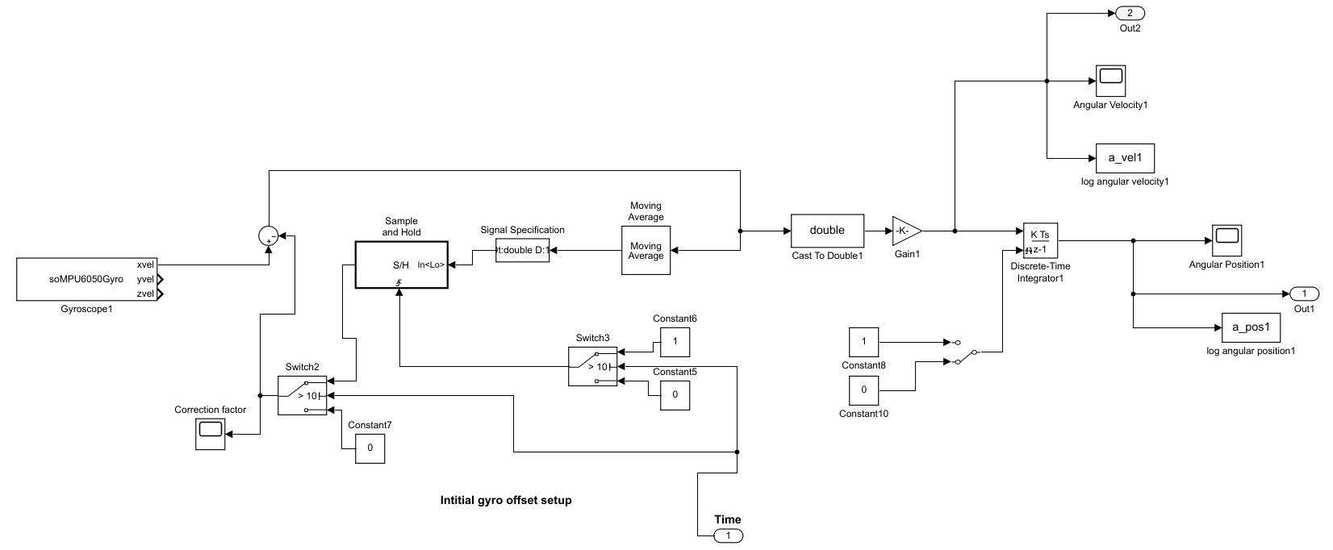
Gyroscope with calibration
Still could not get rid of offset in angular velocity!

Slide 14
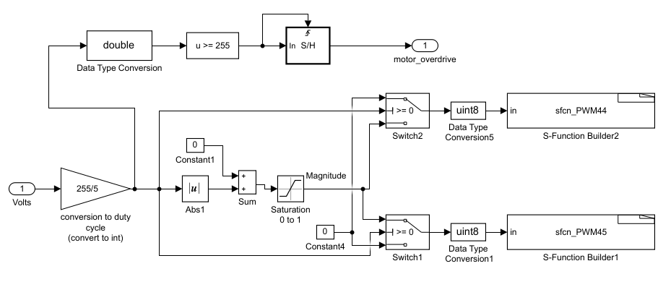
Challenges to set the Gain K
LQR
Q=diag(1 10 10 1)
Q=diag(10 10 10 10)
Q=diag(100 100 1 1)
Q=diag(1 10 1000 1)
Different values of R:
R=1
R=10
R=100
R=0.01
R=0.1
Gain K- too high !!
Pole placement method
poles=[-0.1,-0.2,-0.3,-0.4]
poles=[-67.2,-59.2,-12,-6]
Again Gain K- too high !!
Setting the Gain value very low for all four states
K=[ -1 -1 1 1];
K=[-0.1 -0.1 0.1 0.1]
Motor overdrive Detection

Slide 15
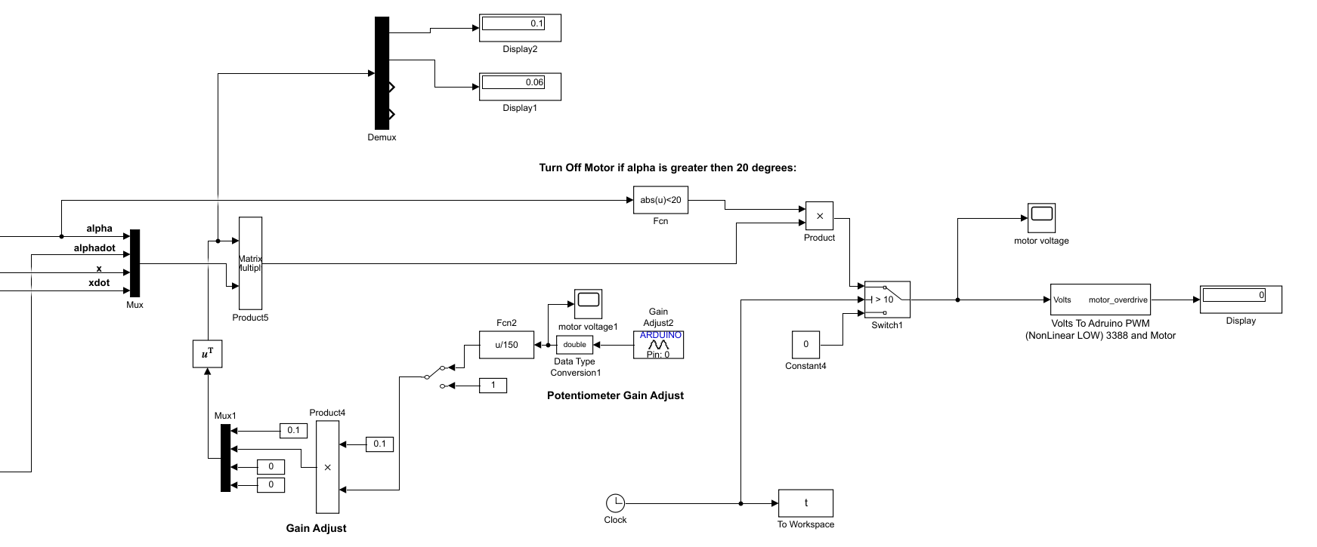
Fine Tuning of Gain K
Alpha
Alphadot
Ratio of Alpha to Alphadot
Challenges with accelerometer signal: Distorted and very low sampling rate.

Slide 16
Ideas for future Implementations
Deeper understanding of LQR cost functions.
Find feedback gain with a more analytical approach rather than empirical.
Hybrid angular position sensing using gyroscope and accelerometer.
Accelerometer resets gyroscope offset when it measures 0 degrees.
Using the Gyro and accelerometer with Complementary Filtering

Slide 17

Video

